Slide 1

Overview of ESG Model Selection
March 17, 2021
Dan Finn, FCAS, ASA – Managing Director at Conning

Slide 2
GEMS® Primary Models Overview
Model | Type | Key Attributes
Interest Rates | 3-factor Affine Model | Realistic yield distributions Produces all commonly observed yield curve shapes including inversions No exploding yields The ability of the model to fit the initial yield curve
Equity | SVJ (Stochastic Volatility with Jumps) | Realistic return and volatility behavior Jump process produces crisis-like events Able to price derivatives, including volatility “smile” Ability to fit to market prices of options
Corporate Bonds | GEMS Corporate Security Model | Model of individual bonds Stochastic spreads and stochastic transition and default incorporated Issuer concentration risk can be captured
 | GEMS Corporate Yield Model | Stochastic spreads Realistic transition and default dynamics Ability to produce the jump-like behavior in spreads observed during the 2008 crisis Market-consistent fits to the initial spread curves Imperfect correlations between spreads

Slide 3
GEMS® Non-Defaultable Term Structure Model
Requirement Base Model | Real world and risk neutral | Closed form bond pricing | (Semi) Closed-form derivative pricing | Can produce skew and kurtosis | Shift twist and butterfly dynamics | Fit the initial yield curve | No exploding yields | Can produce negative interest rates | Estimation methods well-understood
AIRG | ✗ | ✗ | ✗ | ✓ | ✓ | ✓ | ✓ | ✗ | ✗
Multifactor Affine | ✓ | ✓ | ✓ | ✓ | ✓ | ✗ | ✓ | ✗ | ✓
Multifactor Affine (GEMS®) | ✓ | ✓ | ✓ | ✓ | ✓ | ✓ | ✓ | ✓ | ✓

Slide 4
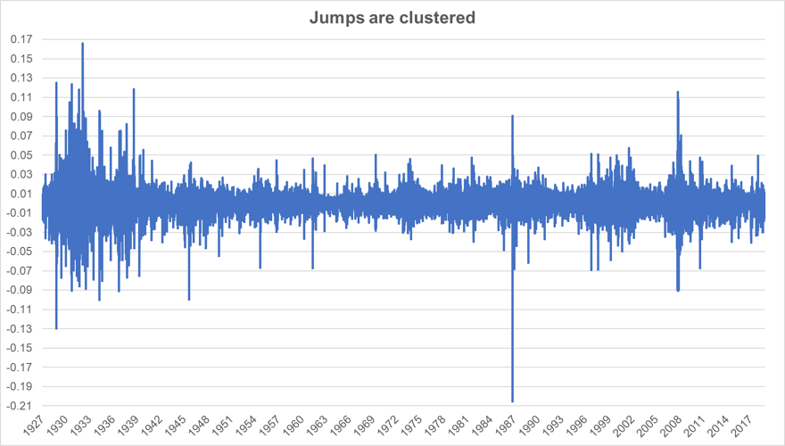
Equity Historical Returns
Source: Bloomberg
Notes:
Here we see 80 years of daily returns for the S&P 500. Note how there have been periods of high volatility and low volatility, often clustered and many “gapping” events over the period. Also markets tend to gap down more than up.

Slide 5
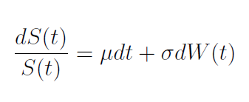
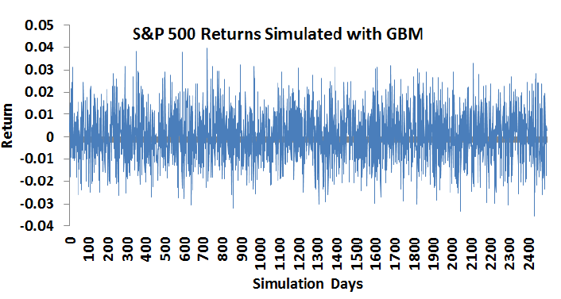
Geometric Brownian Motion
  Simplest “realistic” model of equity returns

Slide 6
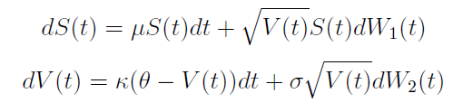
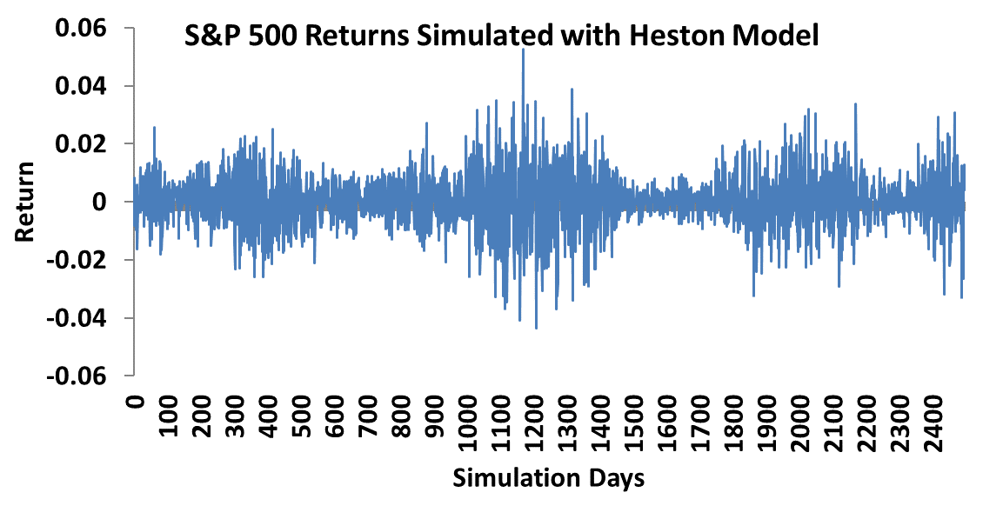
Equity – Heston Model
Next major development
  Has the addition of a mean reverting stochastic volatility term
  The AIRG equity model is in this family

Slide 7
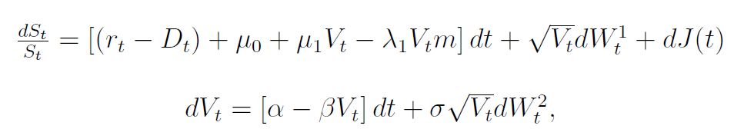
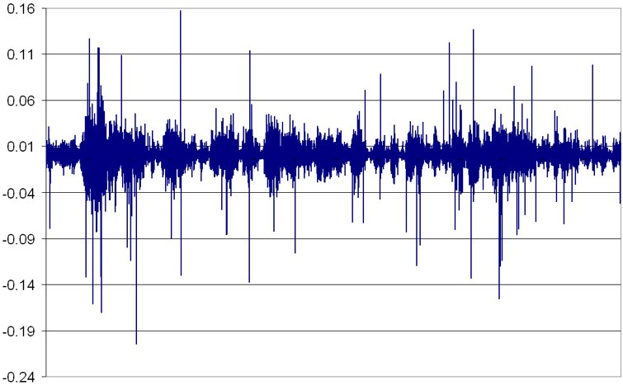
Stochastic Jump Diffusion Model (GEMS)
  Volatility V(t) is stochastic = fat tails/smile/smirk
  Incorporates jumps = jumps clustered
  Corr[dW¹(t), dW²(t)] < 0 = rising prices with low volatility vice versa
Prepared by Conning, Inc. Sources: GEMS® Economic Scenario Generator

